Slide 1

Podcast Visual to be inserted

Slide 2
Disclaimer:
The information provided on this presentation is general in nature and does not constitute personal financial advice. The information has been prepared without taking into account your personal objectives, financial situation or needs. Because of this, you should consider the appropriateness of the information for your own objectives, financial situation and needs before acting on it. Also, before you decide to invest in a financial product arranged by a representative of Nucleus Wealth Management Pty Ltd, ABN 54 614 386 266, corporate authorised representative of Nucleus Advice Pty Ltd AFSL 515796 (Nucleus Wealth or we or us), it is important that you read and consider the Product Disclosure Statement relating to the product before making any decision about whether to invest in it. Your Nucleus Wealth adviser can help you with this decision if you would like them to do so.

Slide 3
Agenda:
Company earnings can be dramatically different to GDP growth. Currently, earnings look far stronger than the US economy.
Politics in the US is fraught. The current trajectory is toward a considerably more dictatorial regime. That doesn't mean a weaker economy/stock market. But extended government shutdowns and civic strife would.
Regulations have been removed. Potentially enough to create future risks for consumers. But, company earnings will be higher.
Tariffs are pushing up inflation, and reduced immigration is pushing up wages - both short term effects. But a weaker economy reduces the medium term risk.
Governments around the world seem much more comfortable spending money and going into debt. Long term yields are rising, increasing the capital cost for companies. But, company profits are likely to be the key beneficiary.
Valuations are extended. But, only really for a handful of the largest stocks. Small, medium stocks are arguably below average in valuation. And the largest stocks have the best growth.

Slide 4
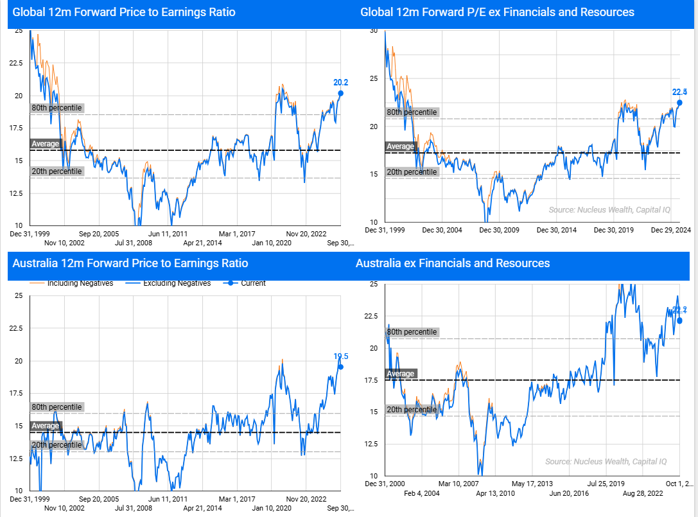
Stocks are expensive:

Slide 5
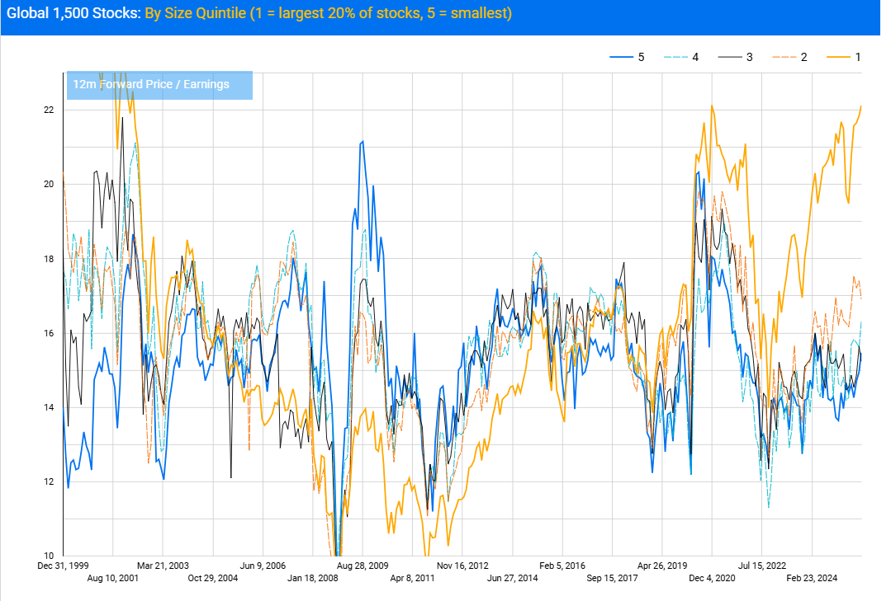
Stocks are expensive: But only really the largest

Slide 6
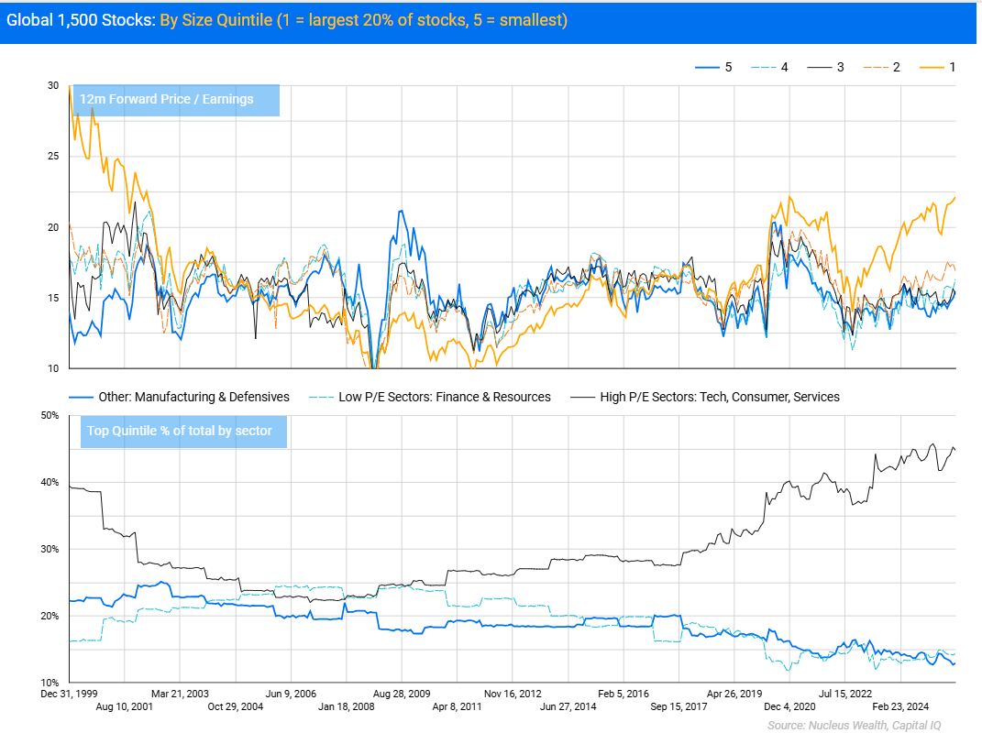
Stocks are expensive: Some of this is sector specific

Slide 7
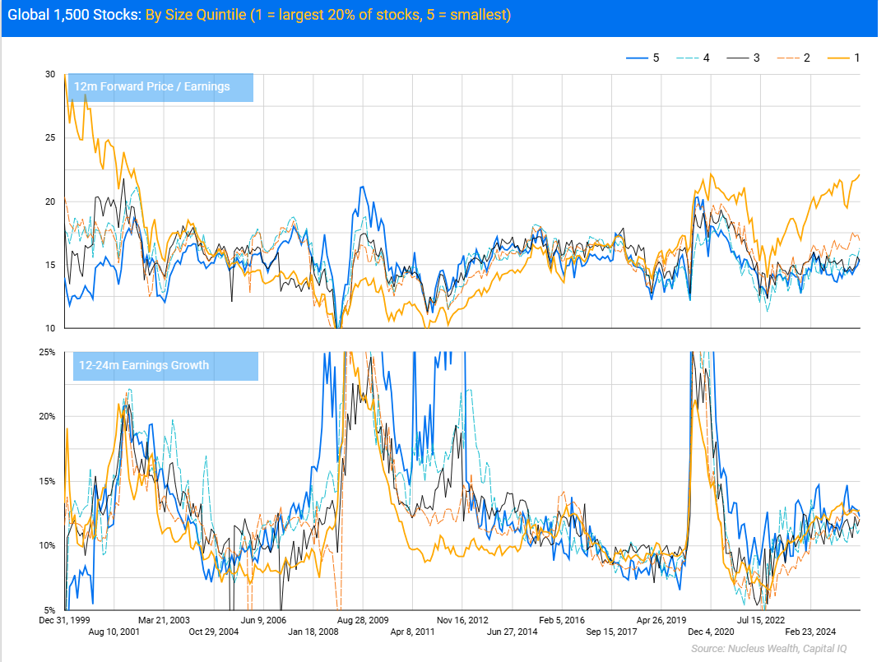
Stocks are expensive: Could it be growth?

Slide 8
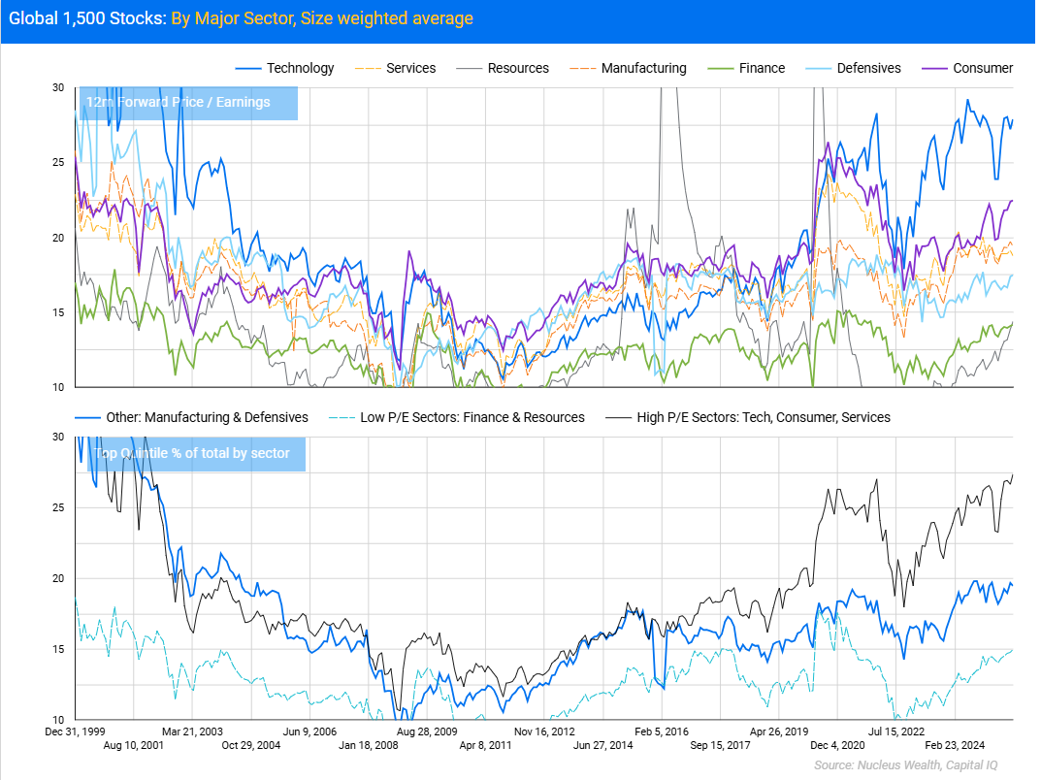
Stocks are expensive: Sector based P/Es

Slide 9
Other
Median doesn’t really change the story
This is global. US vs other countries arguments I don’t really buy.
Many other countries are cheaper. But how much of this is just that they aren’t part of the same basis

Slide 10
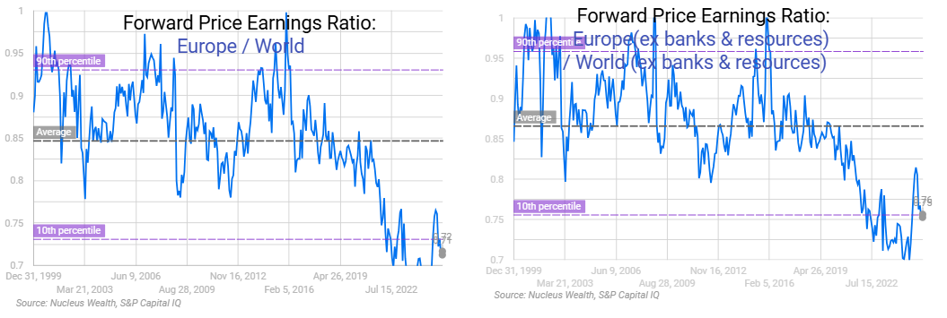
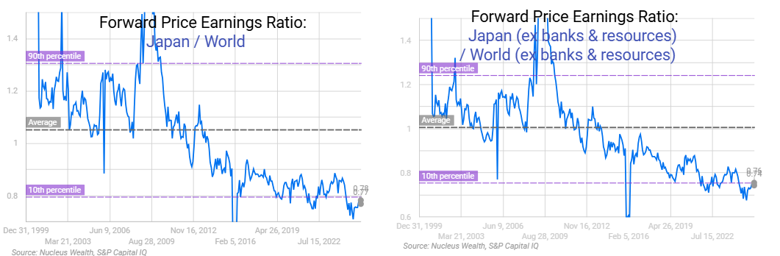
Europe & Japan

Slide 11
Investment Outlook:
Company earnings can be dramatically different to GDP growth. Currently, earnings look far stronger than the US economy.
Politics in the US is fraught. The current trajectory is toward a considerably more dictatorial regime. That doesn't mean a weaker economy/stock market. But extended government shutdowns and civic strife would.
Regulations have been removed. Potentially enough to create future risks for consumers. But, company earnings will be higher.
Tariffs are pushing up inflation, and reduced immigration is pushing up wages - both short term effects. But a weaker economy reduces the medium term risk.
Governments around the world seem much more comfortable spending money and going into debt. Long term yields are rising, increasing the capital cost for companies. But, company profits are likely to be the key beneficiary.
Valuations are extended. But, only really for a handful of the largest stocks. Small, medium stocks are arguably below average in valuation. And the largest stocks have the best growth.

Slide 12
Investment Outlook
I let earnings and revisions guide exposure. The GDP–earnings disconnect is as wide as I’ve seen in years. Macro landmines exist, but if earnings grind higher, equities can hold even as yields shift.

Slide 13
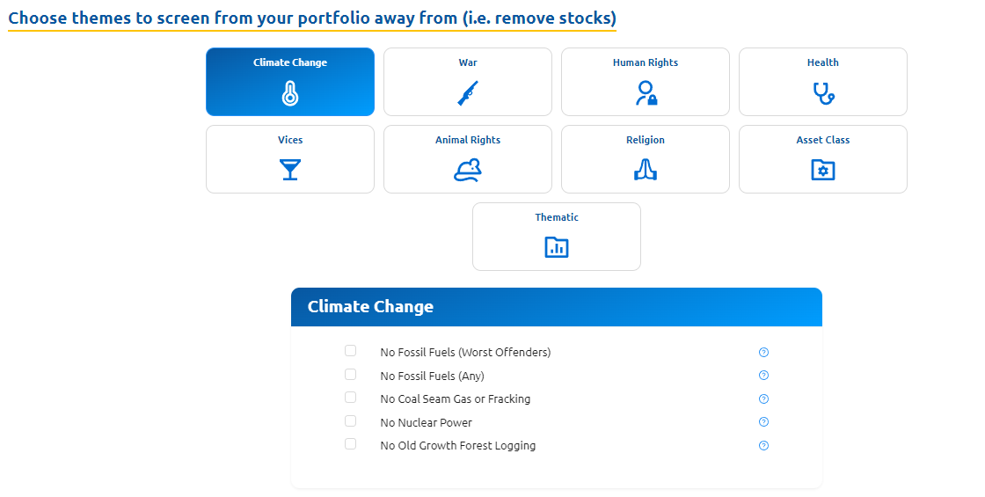

Slide 14
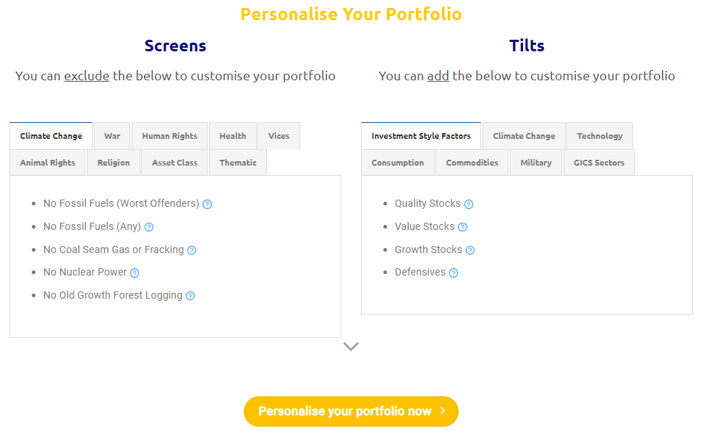

Slide 15
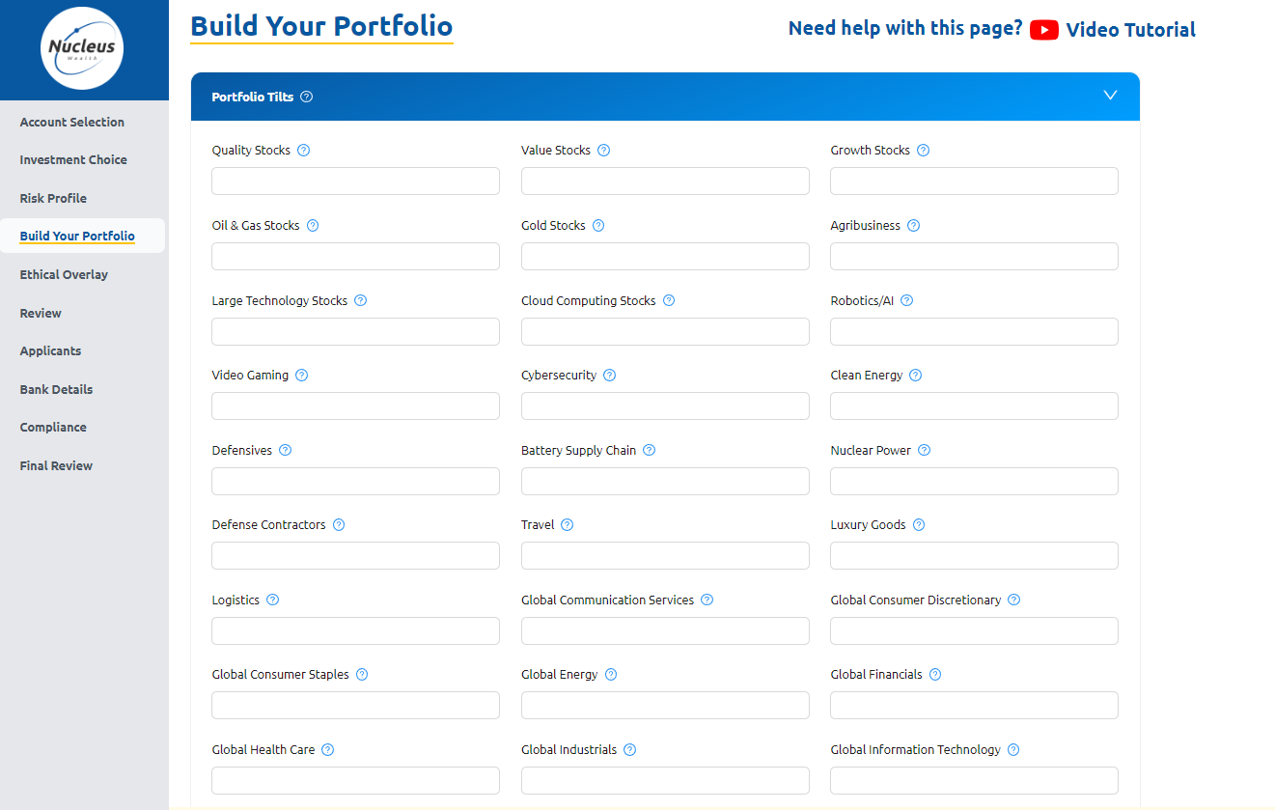

Slide 16







More from Nucleus Wealth:
Content: Nucleuswealth.com/content
Have a guest or topic suggestion for the show?
Leave a comment on YouTube
Social media:
Facebook.com/nucleuswealth
Find us on all major (and minor) podcast platforms:
Linkedin.com/company/nucleuswealth
Instagram.com/nucleus_wealth
Twitter.com/nucleuswealth

